Slide 1
Characteristics of Covid-19 Patients
Ellie Goodman
Notes:
Ellie

Slide 2
Purpose
Project the overall likelihood of death by Covid-19 and predict survival rates based on patient characteristics like sex, age etc.
This Photo by Unknown author is licensed under CC BY.
Notes:
Ellie

Slide 3
Our Data
Data set from Kaggle of 1,048,575 patient deaths in Mexico of 2020
Including patient characteristics
Sex, Patient Type, Age, Diabetes, Obesity, Asthma, Pneumonia and Classification
Notes:
Ellie

Slide 4
Plan
Create 8 functions using the 8 characteristics
Functions Created: getSex, getAge, getPatient, getDiabetic, getObese, getAsthma, getPneumonia, getClassification
Import raw data and calculate the totals of each section and find the percentage and likelihood of death based off each characteristic
Use those calculations to also either create a bar chart or pie chart to visualize results
Imported 3 libraries
Pandas, matplotlib, numpy
Notes:
Haley

Slide 5
Sex
In our data sex was identified by male= 1 and female= 2
There was no relationship found between sex and the death ratio among patients
Code Output
Notes:
Nicole

Slide 6
Age
In our data we were given a range of patients from the ages of 0-100
We broke up those ages in age groups to help identify which ages led to the most deaths
We found that the age groups of the young, young adult and adult had the highest % of death because we believe that they had more contact with people that were infected with Covid-19
Code Output
Notes:
Haley

Slide 7
Hospitalized
In our data we identified patients who were hospitalized = 1 and patients not hospitalized = 2
We found that patients who were admitted into a hospital had a strong relationship to dying from covid
Code Output
Notes:
Nicole

Slide 8
Diabetes
In our data we identified patients who were diabetic = 1 and patients who were not =2
We found that there was not a relationship between patients with diabetes and death from Covid
Code Output
Notes:
Nicole

Slide 9
Obesity
In our data obesity was identified by patients who were identified as obese = 1 and those who were not = 2
Throughout the data, we found that there was not a significant relationship between patients who died from covid and being obese although it was little bit higher than other characteristics
Code Output
Notes:
Nicole

Slide 10
Asthma
In Our data asthma was identified by patients with asthma = 1 and patients with no asthma = 2
There was no relationship found between covid deaths and having asthma
Code Output
Notes:
Ellie

Slide 11
Pneumonia
In Our data pneumonia was identified by patients who got pneumonia= 1 and patients who did not get pneumonia= 2
There was no relationship found between covid deaths and getting pneumonia when having covid
Code Output
Notes:
Ellie

Slide 12
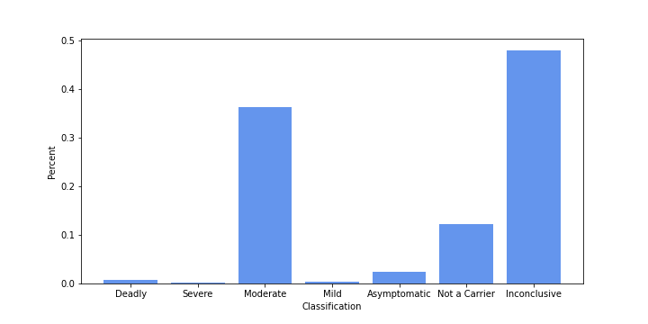
Classification
In Our data we were given Patient Classifications that ranged from 1-7
We found that the patient classification that was inclusive had the highest death ratio of 48%
We believe this is because there were not as accurate Covid- 19 tests has there are today
Code Output
Notes:
Haley

Slide 13
Conclusion
Overall, we found 3 strong relationships with death from Covid-19 with characteristics such as Age, Hospitalization, Classification.
As well as a smaller relationship with patients who were obese
Notes:
Haley

Slide 14
Works Cited
Nizri, Meir. “Covid-19 Dataset.” Kaggle, 13 Nov. 2022, https://www.kaggle.com/datasets/meirnizri/covid19-dataset?resource=download.

